Slide 1

MOSSBAUER SPECTROSCOPY
MOSSBAUER SPECTROSCOPY
PRINCIPLES AND APPLICATIONS
************* Dr.A.Simi, Assistant professor, Department of Chemistry, St.Joseph’s College, Trichy ******************

Slide 2
MOSSBAUER SPECTROSCOPY
Also known as Nuclear Gamma Resonance Spectroscopy.
In this method nucleus absorbs an gamma ray photon and undergoes transition.
First the concept of ϒ photon resonant absorption was suggested by Kuhn-1929
First observed by Mossbauer in 1958
Awarded Nobel prize for this work

Slide 3
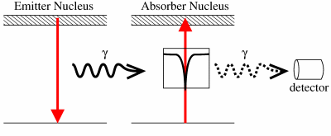

Slide 4
Why it is difficult?
The only suitable source of ϒ radiation is the excited nuclei of the same isotope in the course of radioactive decay.
No way of tuning the energy of the emitted ϒ photon.
The energies involved are much higher and in the order of keV.
Recoil effect

Slide 5
What is recoil?
When ever a high energy particle/projectile is released from a body at rest, the releasing body feels a back-kick i.e. it is pushed backwards, which is called recoil effect.
This is true for absorption of high energy particles also.
The recoil happens to conserve the momentum.
Dr.A. Simi

Slide 6
Recoil continued…
When a gaseous atom or molecule emits a quantum of energy E , the emitted quantum will always have the momentum E/C
Where C – is the velocity of light
To conserve momentum the emitter recoils with momentum P which is equal and in opposite direction.
P = M.V_{R} = -E/C
where V_{R} recoil velocity
- sign shows that its direction is opposite
Dr.A. Simi

Slide 7
E_{R} = P²/2m = E²/2MC²
= (E_{t}-E_{R})²/2MC² ≈ E_{t}/2MC²
Since E_{R} is small
If M increases the recoil energy can be still lower. So the source and the absorber are fixed on a larger lattice to increase mass
Dr.A. Simi

Slide 8

← V_{R}
V_{R} →
Dr.A. Simi

Slide 9
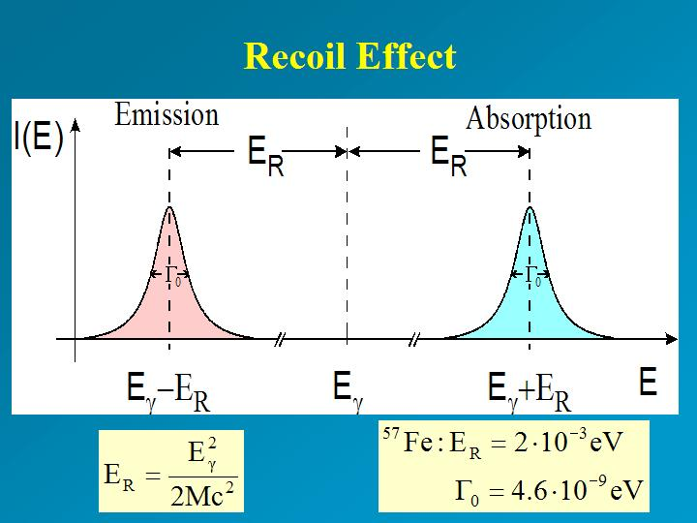
What happens because of recoil effect ?

Slide 10
E.S
E.S
E _{t}
E _{ϒ}
E _{t}
E _{ϒ}
E _{R}
E _{R}
G.S
G.S
Emission [Eγ = E_{t} – E_{R}] Absorption [Eγ = E_{t} + E_{R}]

Slide 11
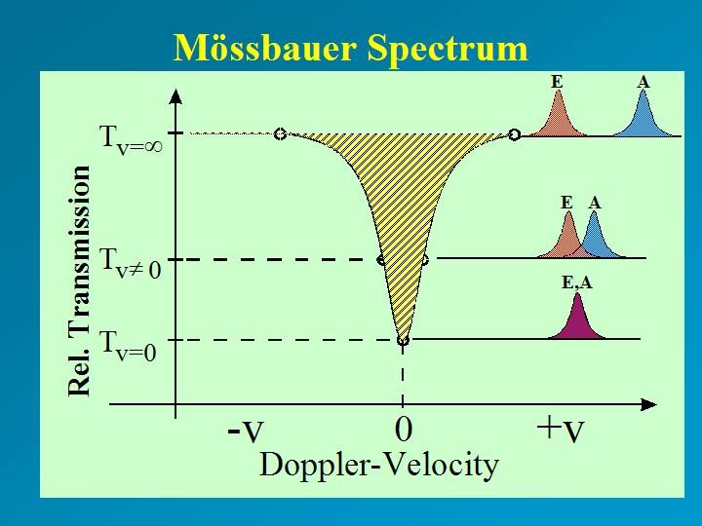
Why recording MB spectrum is difficult?
Dr.A. Simi

Slide 12
What is there in X axis? λ or ν or E?
It is already known that, for spectroscopic technique we need a monochromatic radiation.
But gamma rays are coming out because of the energy difference between the nuclear levels.
We cannot alter it, to change the gamma photon’s energy.
So we use Doppler effect to change the energy of the photon.
Dr.A. Simi

Slide 13
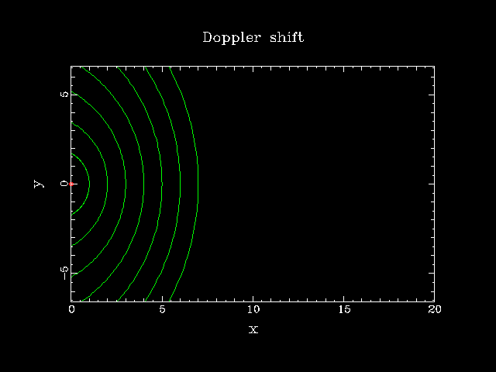
Doppler Effect

Slide 14
Tuning the energy by using Doppler Effect
Source moves towards absorber, ν increases
Source moves away from absorber, ν decreases

Slide 15
Mössbauer Effect
Recoilless Nuclear Resonance Absorption of gamma-Radiation.
The Mössbauer Effect has been observed for about 100 nuclear transitions in some 80 nuclides in nearly fifty elements.
Not all of these transitions are suitable for actual exploitation.
valuable contributions to the physical, chemical, biological- and earth sciences
Dr.A. Simi

Slide 16
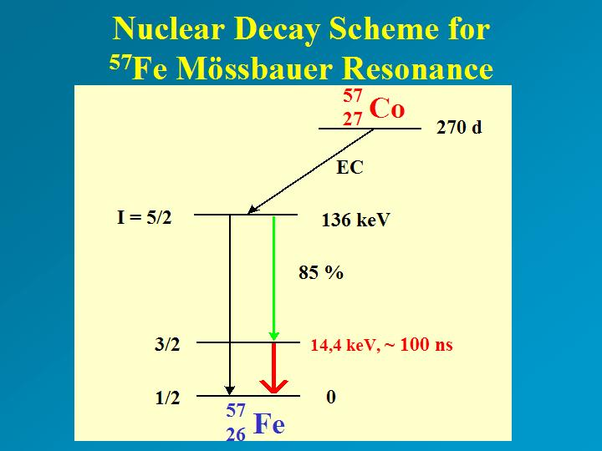

Slide 17
Conditions for MB spectra
The energy of nuclear transition must be large enough to give, useful ϒ ray photon ; but not large enough to cause recoil effect.
The energy of the ϒ ray photon must be in the range of 10 – 150keV.
A substantial amount of the nuclear decay must be with ϒ ray emission.
Dr.A. Simi

Slide 18
…..Conditions continued….
The lifetime of the excited state must be long enough give a reasonably broad emission range. Since, extremely narrow lines are not useful (τ must be 001 – 100 nS)
The excited state of the emitter should be having a long-lived precursor, and easy to handle.
Dr.A. Simi

Slide 19
…..Conditions continued….
The ground state of the isotope should be stable. Its natural abundance should be high or at least the enrichment of that isotope should be easy.
The cross section of for absorption should be high.
Dr.A. Simi

Slide 20
Why Fe is the most studied?
⁵⁷ Co
270 days
⁵⁷Fe*
127.90 k.eV / 91%
⁵⁷Fe* (99.3 nS)
136.32 k.eV / 9 %
14.41 k.eV
⁵⁷Fe
Dr.A. Simi

Slide 21
Why Fe is the most studied?
The precursor of ⁵⁷Fe is ⁵⁷Co which decays to ⁵⁷Fe* with a half life of 270 days (highly stable precursor)
9% of ⁵⁷Fe* decays to ground state directly with emission of ϒ photon of energy 136.32 keV.
91% of ⁵⁷Fe* decays to another excited state with emission of 121.91 keV energy
Dr.A. Simi

Slide 22
The lower excited state is having a life time of 99.3nS (more stable)
This decays to ground state with emission of 14.41 keV.
This transition satisfies all the conditions for MB spectra except 2nd condition.
But it is compensated by larger absorption cross section.
Other elements that can be studied- are ¹¹⁹Sn, ¹²¹Sb, ¹²⁵Te, ¹²⁹I, ¹²⁹Xe and ¹⁹⁷Au
Dr.A. Simi

Slide 23
Recording the MB spectrum
Usually the standard emitter is used as the source.
Sample under investigation is the absorber.
Both the sample and absorber are embedded on a crystal lattice to minimize the recoil effect.
Dr.A. Simi

Slide 24
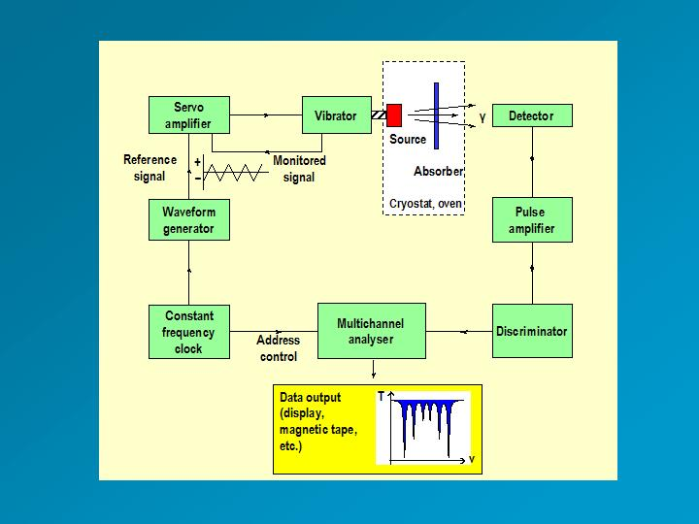
INSTRUMENTATION

Slide 25
Identical source and absorber material; maximum overlap occurs at zero Doppler velocity.
The source for ⁵⁷Fe spectroscopy is commercially available ⁵⁷Co/Rh, is mounted on the shaft of a vibrator.
source is generally kept at room temperature.
Absorber (sample under study) may be cooled down to liquid nitrogen or liquid helium temperatures in a cryostat, or for controlled heating in an oven.
Dr.A. Simi

Slide 26
γ-rays are detected by a scintillation counter, gas proportional counter or a semi-conductor detector.
A constant frequency clock synchronises a voltage waveform which serves as a reference signal to the servo-amplifier controlling the electro-mechanical vibrator.
Dr.A. Simi

Slide 27
The difference between the monitored signal and the reference signal is amplified and drives the vibrator at the same frequency (typically 50 s⁻¹) as the channel address advance.
Each channel corresponds to a certain relative velocity and is held open for a fixed time interval depending on the frequency and number of channels used.
Dr.A. Simi

Slide 28
The incoming γ-counts are collected in their corresponding channels during the sequential accessing e.g. 50 times per second, until satisfactory resolution is reached.
The cryostat can be furnished with a super-conducting solenoid for measuring the sample in an applied magnetic field.
It is also possible to mount a pressure cell inside the cryostat for studying the sample properties under pressure.
Dr.A. Simi

Slide 29
ISOMER SHIFT / CENTRE SHIFT / CHEMICAL SHIFT
The E_{t} value is affected by the interaction between the nucleus and the e⁻s present around it.
This arises because of the different sizes of nucleus in ground and excited states.
The change in nuclear radius when going from g.s to e.s is ΔR
Z is the atomic number
Dr.A. Simi

Slide 30
Isomer shift
The change in electrostatic energy on decay is given by (chemical shift / Isomer shift)
δ= (ε₀/5) (Ze²R²)(Δ R/R)[|ψ_{s}(abs)|²-|ψ_{s}(source)|²]
where
ε₀ – Permittivity of free space
Z - atomic number of the nucleus
e - electronic charge
ψ_{s}(abs) - s orbital wave function of absorber
ψ_{s}(source) - s orbital wave function of source
Dr.A. Simi

Slide 31
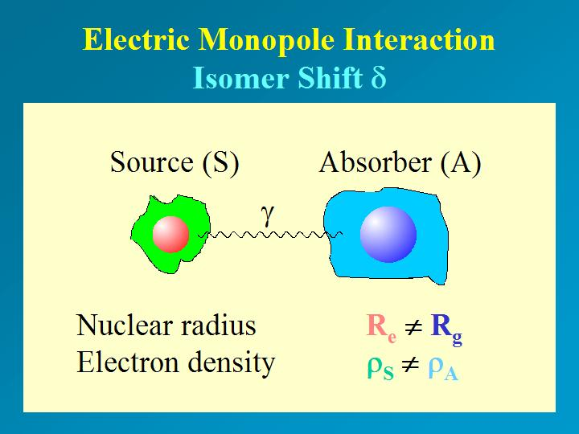

Slide 32
Since s electron wave functions have their maxima at the nucleus, s electron density affects the isomer shift to a great extent.
But changes in p & d orbital occupancies affect the s electron through screening hence have a smaller effect on isomer shift.
When ΔR/R is positive the isomer shift is also positive and negative ΔR/R reflected as negative shift
Dr.A. Simi

Slide 33
Isomer shift is related to the oxidation state of the metal.
In ¹¹⁹Sn MB spectra Sn(II) shows a positive shift (ΔR/R ) w.r.to Sn where as for Sn(IV) it is negative
s - electron density decreased so negative shift
Species | configuration | ΔR/R | δ
Sn(IV) | 5s⁰5p⁰ | - ive | -ive
Sn | 5s²5p² | 0 | 0
Sn(II) | 5S²5p⁰ | +ive | +ive
s - electron density increased – p screening not present, so positive shift

Slide 34
In ¹¹⁹Sn compounds, the shift values depend on the ligands present and the coordination number of tin.
The isomer shift values are useful in characterizing tin derivatives.
Many Sn compounds appear to contain Sn(II) from the formulae but on analyzing with MB spectra Sn(IV) is present in them.
Dr.A. Simi

Slide 35
Many of them are polymeric and contain Sn(IV).
Generally Sn(II) compounds show shift > than 2.1 mmS⁻¹ and Sn(IV) show shift < 2.1 mmS⁻¹ (With relative to SnO₂)
The point of changeover is a dispute but shifts less than 2 are for Sn(IV) and above 2.5 are clearly for Sn(II)
Dr.A. Simi

Slide 36
Organotin compounds
The isomer shift of (SnPh₂)_{n} is 1.5 mm/S clearly showing the presence of Sn(IV).
A similar formula Sn(C₅H₃)₂ is having a monomeric structure in the solid state and shows a shift of 3.74 mm/S.
Dr.A. Simi

Slide 37
Chemical shift values for Fe compounds
Fe isomer shift cannot be used for determining the O.S of Fe in a molecule.
Fe O.S from 0 to 4, often differ in unit charge only.
The electrons involved are from d orbital. So effect on the s electrons is smaller.
Varying spin states(which depends on the ligands present) also affect the shift value.
Dr.A. Simi

Slide 38
Anyway some useful correlations had been drawn.
Fe-porphyrin complexes are very important biologically.
Fe can be present in +2 or +3 state in them.
The complexes can be easily reduced. The electron may be to the Fe or to the ligand. In that ambiguous case MB spectra is useful in determining the O.S
Dr.A. Simi

Slide 39
Even though assignment of O.S is often possible, in some cases like ¹⁹⁷Au many oxidation states show shift values considerably overlapping.
In that case, MB spectrum can only be used as a supporting evidence and cannot be used for ascertaining the oxidation state.
In addition, the isomer shifts are with relative to a standard only. Different studies have used different standards. So it is important to mention which standard was used. For ⁵⁷Fe – [Fe(CN)₅NO],¹¹⁹Sn-SnO₂
Dr.A. Simi

Slide 40
Electric Quadruple Interactions
Nuclei in states with an angular momentum quantum number I>1/2 have a non-spherical charge distribution. This produces a nuclear quadruple moment.
In the presence of an asymmetrical electric field (produced by an asymmetric electronic charge distribution or ligand arrangement) this splits the nuclear energy levels.
The charge distribution is characterized by a single quantity called the Electric Field Gradient (EFG).
Dr.A. Simi

Slide 41
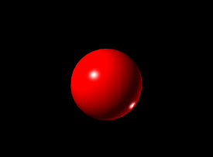
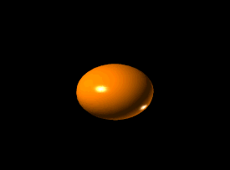
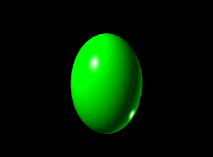
SPHERICAL Q IS 0
OBLATE Q IS -IVE
PROLATE Q IS +IVE

Slide 42
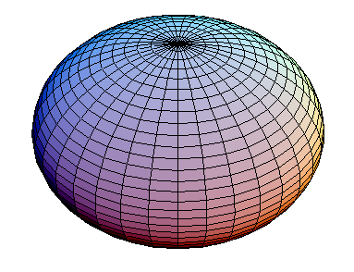

Oblate and Prolate nuclei

Slide 43
In the case of an isotope with a I=3/2 excited state, such as ⁵⁷Fe or ¹¹⁹Sn, the excited state is split into two sub states m_{I}=±1/2 and m_{I}=±3/2.
This gives a two line spectrum or 'doublet'.
The magnitude of splitting, Delta, is related to the nuclear quadrupole moment, Q, and the principle component of the EFG, V_{zz}, by the relation Δ=eQV_{zz}/2
Dr.A. Simi

Slide 44
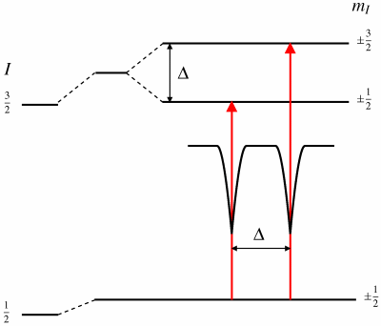
Quadruple Splitting for ⁵⁷Fe and ¹¹⁹Sn

Slide 45
±5/2
I_{e} = 5/2
±3/2
Selection Rule for MB spectra m_{I} = 0,±1
±1/2
±7/2
±5/2
I_{g} = 7/2
±3/2
±1/2

Slide 46
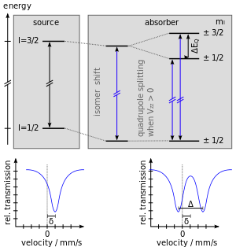

Slide 47
Informations from quadruple splitting
Appearance of quadruple splitting shows the presence of efg at the nucleus.
The efg may be created by the ligand field or by the electron distribution aroung the nucleus.
Single crystal or application of magnetic field gives more information.
If a nucleus with symmetric electron distribution is in an O_{h} field, efg is not expected.
Dr.A. Simi

Slide 48
Stereochemical activity of lone pair
Consider Te(IV) compounds with six ligands
If the lone pair of electron of Te is stereochemically active , it will occupy one vertex of a pentagonal bipyramide(pbp)
This will create an efg at the nucleus, resulting in q.s
But no q.s in these class of compounds.
So the lone pair is stereochemically inactive
It occupies the 5s orbital
Dr.A. Simi

Slide 49
Structures of the TeX₄Y²⁻ had not been crystallographically studied.
The MB spectra of those species shoe no q.S, but this is not a conclusive evidence for absence of efg at nucleus.
The efg may not be enough to cause q.s.
But inCsIF6 substantial q.s shows the stereochemical activity of lone pair.
Dr.A. Simi

Slide 50
Magnetic interactions
:In the presence of a magnetic field the nuclear spin moment experiences a dipolar interaction with the magnetic field ie Zeeman splitting
There are many sources of magnetic fields that can be experienced by the nucleus.
The total effective magnetic field at the nucleus, B_{eff} is given by
B_{eff} = (B_{contact} + B_{orbital} + B_{dipolar}) + B_{applied}
Dr.A. Simi

Slide 51
The first three terms being due to the atom's own partially filled electron shells.
B_{contact} is due to the spin on those electrons polarising the spin density at the nucleus
B_{orbital} is due to the orbital moment on those electrons, and B_{dipolar}is the dipolar field due to the spin of those electrons.
Energy of the nuclear levels E_{m}= -gμ_{N}Bm_{I}
Dr.A. Simi

Slide 52
This magnetic field splits nuclear levels with a spin of I into (2I+1) substates.
Transitions between the excited state and ground state can only occur where m_{I} changes by 0 or 1.
This gives six possible transitions for a 3/2 to 1/2 transition, giving a sextet , with the line spacing being proportional to B_{eff}.
Dr.A. Simi

Slide 53
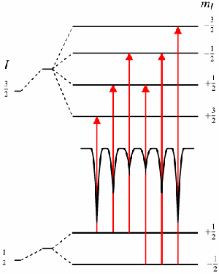
Effect of magnetic field on ⁵⁷Fe

Slide 54
The line positions are related to the splitting of the energy levels, but the line intensities are related to the angle between the Mössbauer gamma-ray and the nuclear spin moment.
The outer, middle and inner line intensities are related by:
3 : (4sin²θ)/(1+cos²θ) : 1
Dr.A. Simi

Slide 55
Outer and inner lines are always in the same proportion.
The middle lines can vary in relative intensity between 0 and 4 depending upon the angle the nuclear spin moments make to the gamma-ray.
In polycrystalline samples with no applied field this value averages to 2,
But in single crystals or under applied fields the relative line intensities can give information about moment orientation and magnetic ordering.
Dr.A. Simi

Slide 56
Applications of
Mossbauer spectra

Slide 57
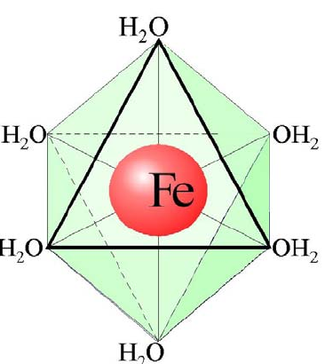
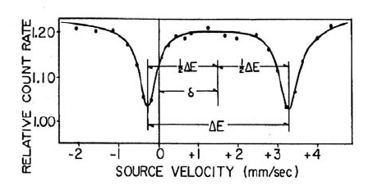
Spectra of spin free Fe(II) – FeSO₄.7H₂O

Slide 58
From the crystallographic data it was initially concluded that FeSO₄.7H₂O is having a perfect O_{h} symmetry, with six H₂O on each vertex.
But the MB spectrum recorded showed a large quadruple splitting, which is not possible in a regular O_{h} symmetry. (for perfect O_{h} field efg is zero)

Slide 59
Fe(II) is a d⁶ system.
In weak field created by H₂O, an orbitally degenerate system results.
This under goes J-T distortion (Z _{in})to remove the degeneracy and forms a tetragonal field.
This creates an efg at the nucleus and hence quadruple splitting.
The structure assigned is an distorted O_{h} with all angles 90º and x ≠ y ≠ z

Slide 60
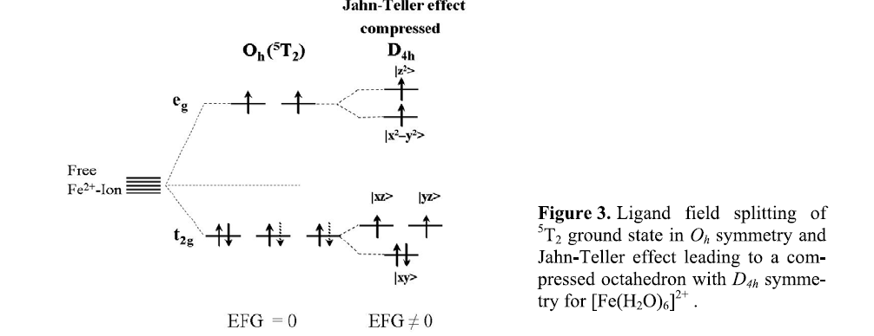

Slide 61
Prussian Blue and Turnbull’s blue
Prussian blue is a dark blue pigment with the idealized formula Fe₇(CN)₁₈. it is prepared by adding a ferric salt to ferrocyanide
Fe³⁺ + [Fe²⁺(CN)₆] ⁴⁻ Fe³⁺₄[Fe²⁺(CN)₆]₃
Turnbull's blue is the same substance but is made from different reagents , i.e. addition ferrous salts to ferricyanide.
Fe²⁺ + [Fe³⁺(CN)₆] ³⁻ Fe³⁺₄[Fe²⁺(CN)₆]₃
Its lightly different color stems from different impurities.

Slide 62
For a long time one had considered them as chemically different compounds.
Prussian Blue with [Fe^{II}(CN)₆]⁴⁻ anions and Turnbull’s Blue with [Fe^{III}(CN)₆]³⁻ anions, according to the different way of preparing them.
However, the Mössbauer spectra recorded by Fluck et al., were nearly identical for both PB and TB showing only the presence of [Fe^{II}(CN)₆]⁴⁻ and Fe³⁺ in the high spin state.

Slide 63
This could be confirmed by use of K₄[Fe^{II}(CN)₆] and K₃[Fe^{III}(CN)₆] as reference compounds.
Immediately after adding a solution of Fe²⁺ to a solution of [Fe^{III}(CN)₆]³⁻ a rapid electron transfer takes place from Fe²⁺ to the anion [Fe^{III}(CN)₆]³⁻ with subsequent precipitation of the same material .
A singlet for Fe(II) and a quadruple doublet for Fe(III) were which confirmed Prussian blue and Turnbull’s blue are identical

Slide 64
Fe(II) – L.S – efg = 0- Q.S not present
Fe(III) – L.S – efg ≠ 0
Q.S present
Fe(II) – H.S – efg ≠ 0
Q.S present
Fe(III) – H.S – efg = 0
Q.S not present

Slide 65
The Fe(II) centers, which are low spin, are surrounded by six carbon ligands in an octahedral configuration.
The Fe(III) centers, which are high spin, are octahedrally surrounded on average by 4.5 nitrogen atoms and 1.5 oxygen atoms (the oxygen from the six coordinated water molecules).
This introduces an efg at Fe(III) nucleus and hence Q.S

Slide 66
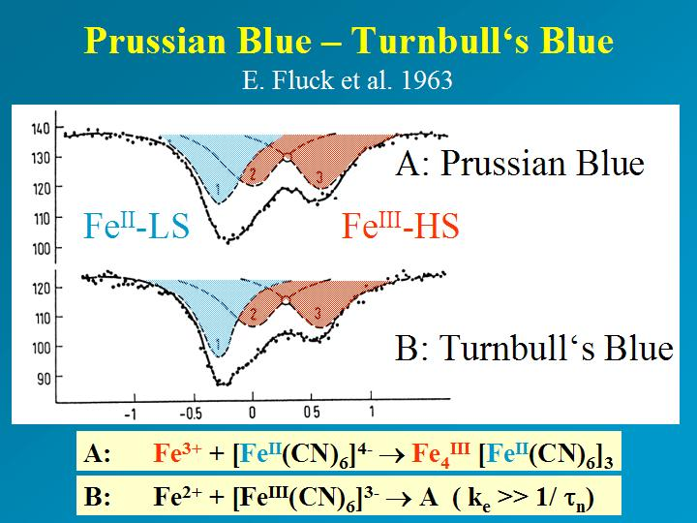
.

Slide 67
Sodium nitroprusside – Na₂[Fe(CN)₅(NO)]
The O.S of Fe in nitroprusside was a matter of controversy for a long time.
Initially it was assumed that it contained Fe(II) and NO⁺ since it was diamagnetic. [Fe(II)-d⁶; Fe(III) –d⁵]
But the MB spectrum of the sample showed a doublet with δ = -0.165 mm/S
This value is too negative for a Fe(II) complex.

Slide 68
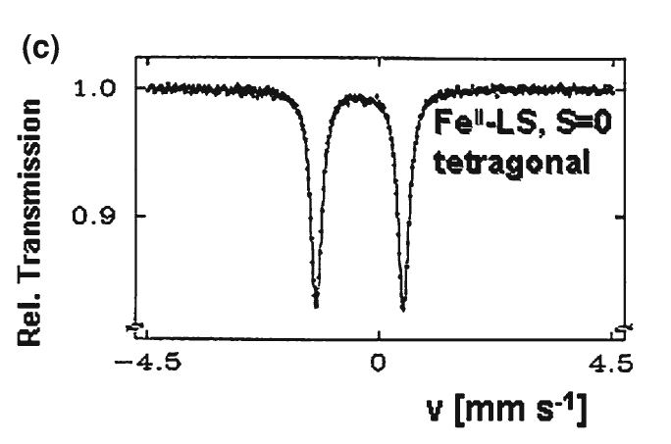

Slide 69
This suggests that the Fe may be in Fe(IV) state.
The magnetism and MB spectrum are in consistent with the structure which has an extensive π-bonding with ⁺NO ligand .
The t₂g orbitals of Fe and the p-orbital of N present in ⁺NO containing the odd e-, to form a π-bond

Slide 70
The Fe(II) is transferring the e⁻s form filled t₂g level to the vacant π- antibonding orbital of NO.
This makes the shift value to approach Fe(IV) values.
Now because of this the shielding of s-e⁻ by the d e⁻s decreases and hence the shift becomes more.
This is supported by the decrease in N-O stretching frequency in IR, since the anti bonding level is filled.

Slide 71
K₄[Fe(CN)₆] is a 3d⁶ LS complex with O_{h} symmetry, where all six electrons are accommodated in the three t_{2g} orbitals.
Both contributions (EFG)_{val} and (EFG)_{lat} vanish; there is no quadrupolar interaction.
Na₂[Fe(CN)₅NO]2H₂O has C_{4v} symmetry with d-orbital splitting as shown.

Slide 72
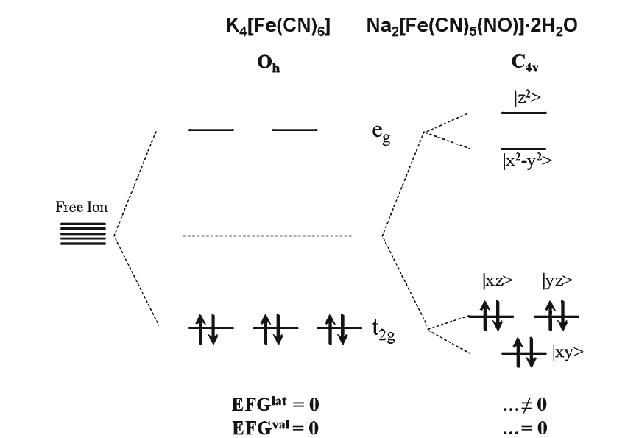

Slide 73
Its LS behavior requires that all six electrons are accommodated in the lowest three orbitals arising from the tetragonal splitting of the former cubic t2g (Oh) subgroup.
(EFG)_{val} is still zero, but (EFG)_{lat} ≠ 0 arises from the ligand replacement in the iron coordination sphere.

Slide 74
The isomer shift data for the pentacyano complexes of iron(II) with a different sixth ligand X.
Normalizing the isomer shifts to that of the pentacyanonitrosylferrate complex as zero point
The ordering expresses the varying effects of d_{π}-p_{π} back donation for the different sixth ligand X.
The isomer shift values become more positive on going from NO⁺ to H₂O

Slide 75
d_{π}-p_{π} backdonation decreases causing an increasing d-electron density residing near the iron centre.
Stronger shielding of s-electrons by d-electrons, which finally creates lower s-electron density at the nucleus.
The nuclear factor ΔR/R is negative for ⁵⁷Fe explains the increasingly positive isomer shift values in the given sequence from NO⁺ to H₂O

Slide 76
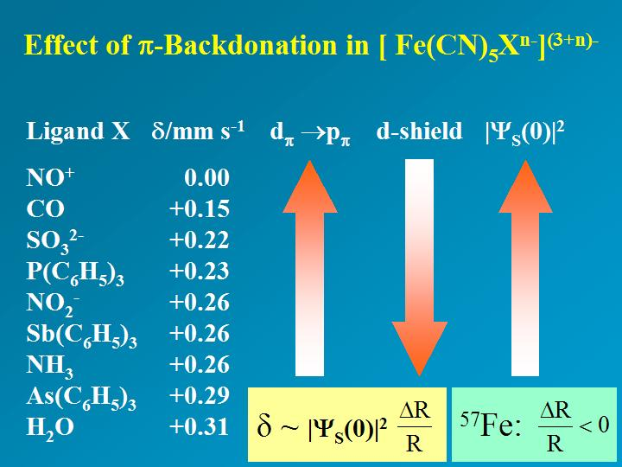

Slide 77
Ferredoxin
Study of ferredoxin, a Fe-S protein, which assists in in-vivo e⁻ transfer reactions
The two-iron centres are not equivalent in the reduced form.
The oxidized form with two Fe(III)-high spin centres can be distinguished from the reduced form with one Fe(III)-high spin centre and one Fe(II)-high spin centre only by using MB spectrum

Slide 78
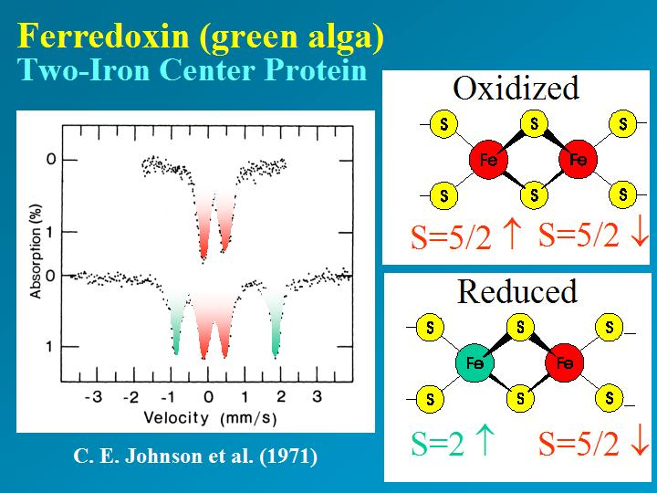

Slide 79
Study of thermal spin-cross over
Many coordination compounds possessing intermediate ligand field strengths show thermal spin crossover. [ i.e. HS <--> LS]
[Fe(phen)₂(NCS)₂] undergoes thermal spin transition .
The main result is that in the temperature region, where the MAS spectra reflect the transition to the LS state, the MES spectra still show the typical HS signals arising from excited ligand field states

Slide 80
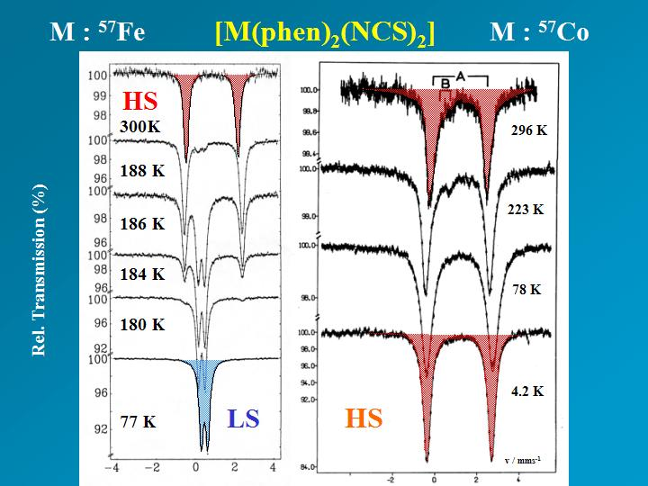

Slide 81

QUESTIONS???

